Slide 1

Title page
A “Cookbook” for
Preparing Your Own Notes on Your
Legislative Priorities Information Sheet
Open in “Reading View” from the View pull down menu and
adjust the window size to use this exercise along side your
Legislative Priorities information sheet and the Legislature’s website.
Introduction
CONTENTS
Get Started
Find a Legislator or Bill?

Slide 2

Intro-1
Brings a Quaker voice, guided by testimonies and spiritual devotion, to the formation of public policy in Washington state.
We primarily lobby the Washington State Legislature in the areas of
Criminal Justice
Economic Justice
Environmental Stewardship
NEXT
CONTENTS
Links to move around within this “Cookbook”

Slide 3
Intro-2 n
Each year Quaker Voice hosts Quaker Lobby Day for Friends to visit their legislators to
Build relationships,
Let them know our concerns in these areas, and
Listen to them.
Each citizen lobbyist and legislator is provided a reference sheet describing the Legislative Priorities identified by the working group in each area.
NEXT
CONTENTS

Slide 4
Intro-3 n
Participating Friends may find it useful to annotate a copy of these
Legislative Priorities for their own use.
The annotations might include.
The names and emails of others from their Legislative District (LD)
The names of their Representatives and Senator, along with their committee memberships and leadership roles
Whether their Representatives or Senator sponsored any of our priority bills
Where bills stand in the legislative process
NEXT
CONTENTS

Slide 5
Intro-4 n
This “Cookbook” is an exercise in annotating a Legislative Priorities information sheet with data from the Legislature’s website, http://www.leg.wa.gov/
You may find this useful when speaking with your Legislators
And you will become more familiar with the Legislature’s website and the wealth of information available on it.
NEXT
CONTENTS

Slide 6
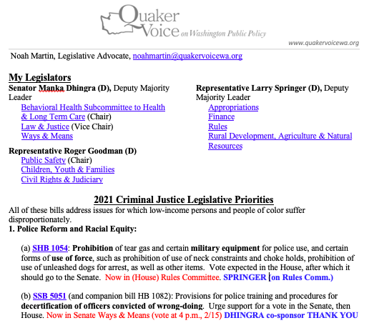
An Example of Possible Notes
45th Legislative District (LD) Legislators, their leadership roles and committees
The bill’s status in the legislative process today
Notes about Legislators
NEXT
CONTENTS

Slide 7
Helpful Information from the
Legislature’s Website
Your Legislators’ Committees
Your Legislators’ Leadership Roles within their Party and Committees
Sponsors for the Quaker Voice Priority Bills, especially if your Legislator sponsored one of them
Where the Priority Bills are in the Legislative Process
Having this information handy may contribute to what you say in a meeting, for example, membership in a committee considering one of our bills or sponsoring one of our bills (thank them).
Get Started
INDEX

Slide 8
Contents
Information About Legislators
Introduction
Information About Bills
Getting Started
Look for Info on Legislators
Find the Number of a QV Priority Bill
Find your Legislative District (LD)
Search for the Bill by Number
Find your Senator
Legislature’s Bill Information
Find each Representative
Record Bill Information
The Essentials for each Legislator
Record Legislator’s Information
DONE
Happy Lobbying

Slide 9
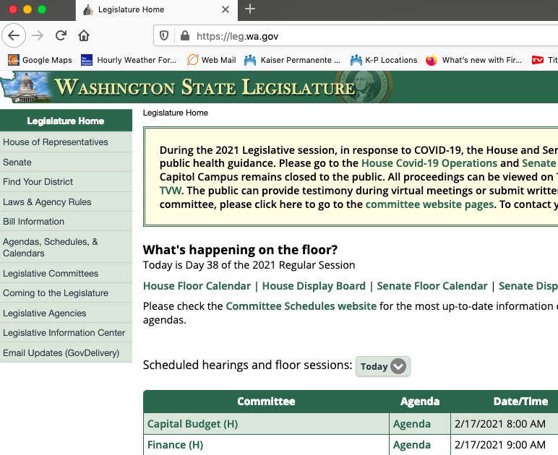
Getting Started
To use this guide, click on this link leg.wa.gov to open the Legislature’s home page.
Also open your Quaker Voice Legislative Priorities reference sheet. Move between
this guide,
the website
your Legislative Priorities sheet
as you work through these instruction.
NEXT
INDEX

Slide 10

Looking for Information on Bills or Legislators?
Use the left sidebar on every page to navigate the Legislature’s website.
Looking for information on Legislators?
Follow for a guide to find
information about Legislators.
Looking for information on bills?
Follow for a guide to find
This LINK
This LINK
INDEX

Slide 11
Do you know your legislators’ names?
YES
NO
Search by name or Legislative District (LD) for information on each
YES
Do you know your Legislative District (LD)?
Legislator
NO
from your address
and links to your legislators’ information
Find Your District
INDEX

Slide 12
To Find Your Legislative District
From any page on leg.wa.gov click
on
in the left sidebar
NEXT
INDEX

Slide 13

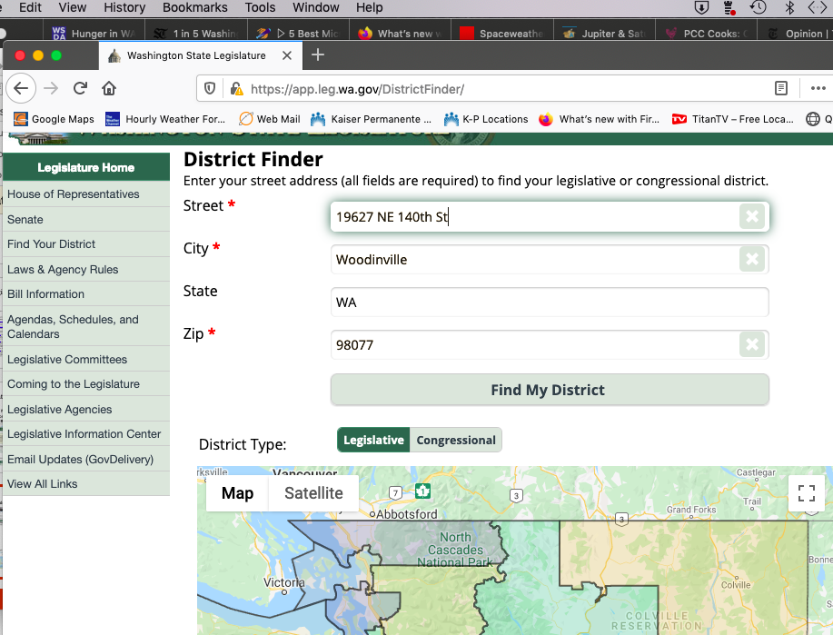
Provide your Address and Click on
You can also find your Congressional District from this web page
NEXT
INDEX

Slide 14
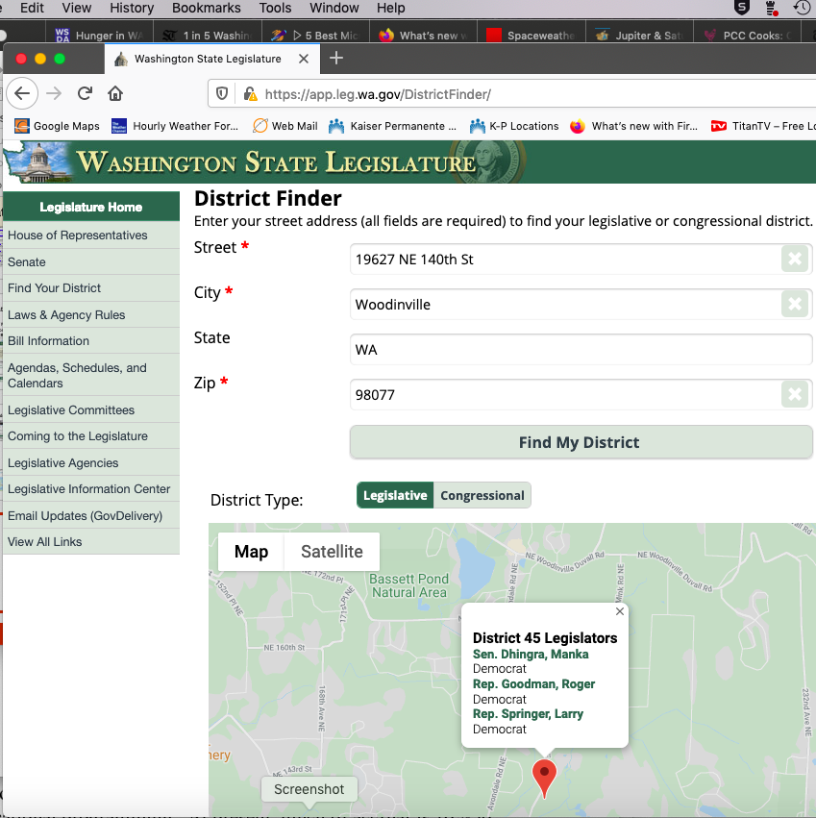
Your LD & legislators
The search result provides
your Legislative District,
your Senator and two
Representatives.
Click on the name of each
to learn
about them.
Legislator
Look for Bill Information
INDEX

Slide 15
Search for your Legislators by
Name or Legislative District
From any page on leg.wa.gov click on
or
in the left sidebar
House of Representatives
Senate
INDEX

Slide 16
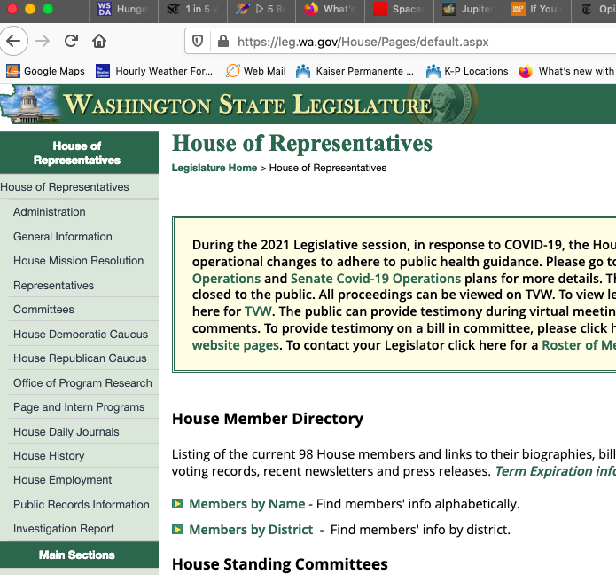
The Extra Step to Search for Representatives
From the House of Representatives home page, select either
or
from the main panel.
It won’t matter, because it is the same list sorted differently. You can then filter this list by name or district.
Members by Name
Members by District
INDEX

Slide 17
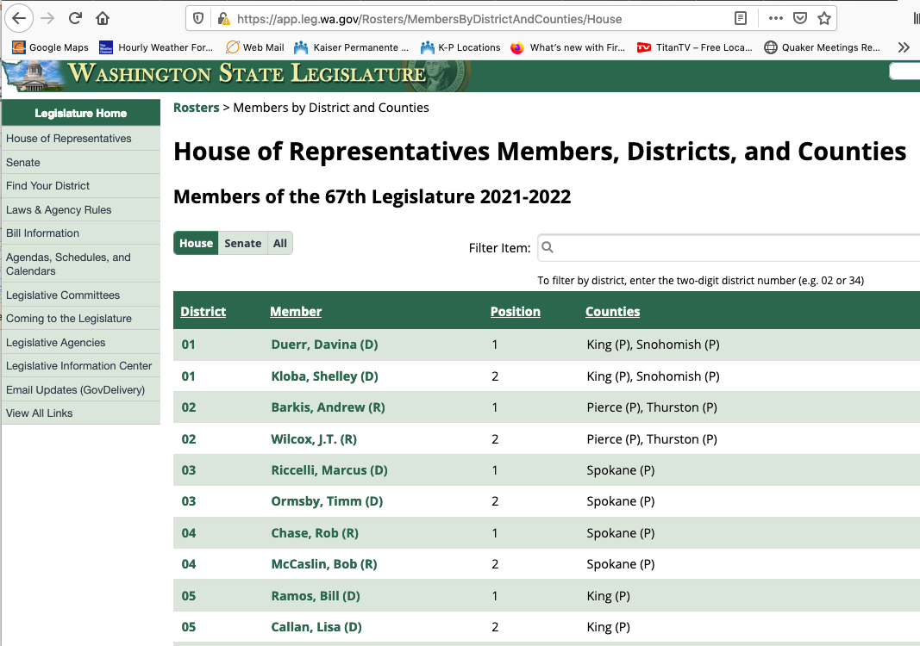
House list
Since you want information about both Representatives, it is quickest to filter by entering the number of your Legislative District. Then links for both Representatives will be displayed. If you don’t know your district, search on the name of one Representative. The Legislative District appears to the left of each Representative’s name and can be filtered on to find your second Representative.
NEXT

Slide 18
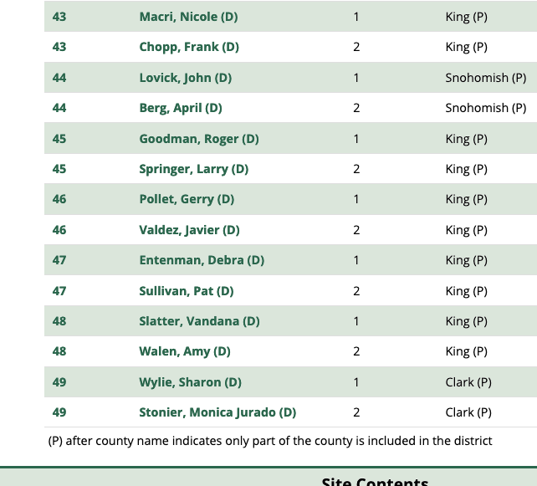
45th LD Reps
Click on each Representative’s name for their pertinent information in an expanded list of all Representatives. Return to this web page for your other Representative.
A Typical Legislator’s Page
Find Your Senator
Find Bill Information
INDEX

Slide 19
To Find Your Senator
From any page within leg.wa.gov click on
in the left sidebar.
NEXT
INDEX

Slide 20
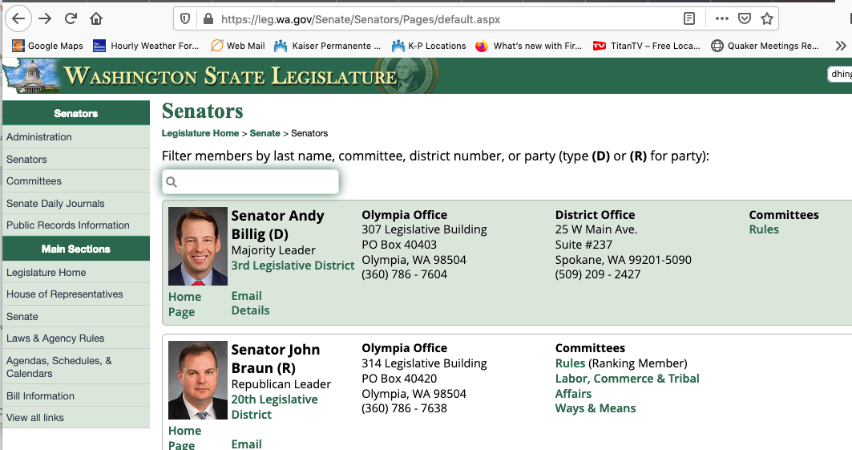
Senate List
Search using any of these filters to find your Senator, e.g., “45” or “Dh” will quickly bring up Sen. Dhingra.
NEXT

Slide 21
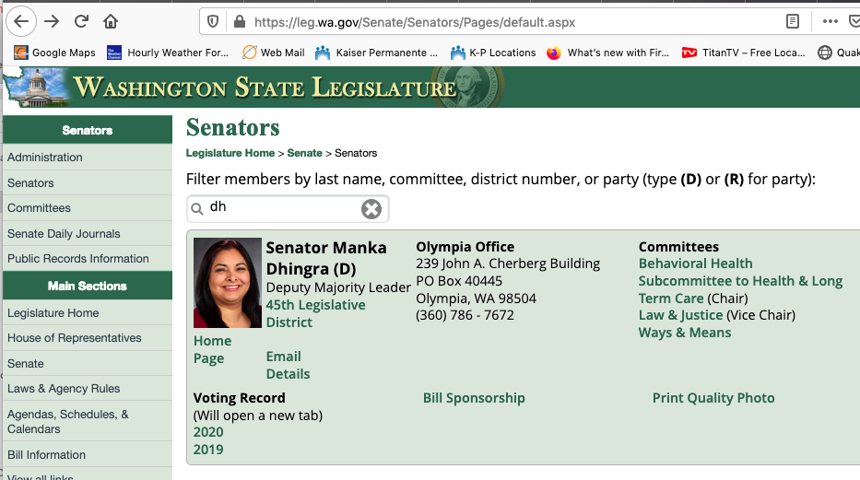
A Legislator’s Essential Information
Copy helpful informative onto your Quaker Voice Legislative Priorities
Representatives’
pages have
the same layout
For meeting in person
Committee leadership
Party leadership
Click on Details to see the information below the red dashed line.
Searching for whether she sponsored any of our bills
Is easiest from the link on the left sidebar.
Bill Information
Record Info.
INDEX
Find Another Legislator

Slide 22
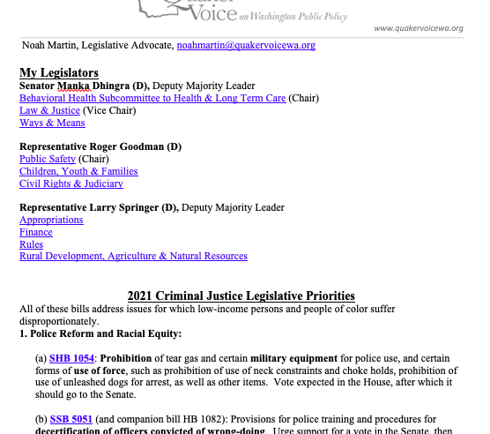
Copy & Paste Legislators’ Useful Information into your Quaker Voice Legislative Priorities
Anywhere convenient is OK. This is for your use; make it work for you.
Find Another Legislator
Find Bil lInformation
Although there are multiple ways to link to this information about Legislators and Bills, these directions should get you started.
DONE
INDEX

Slide 23
Quaker Voice Priority Bill Information
First, find the number of the bill you want to learn about among the Quaker Voice Legislative Priorities.
To search for a bill, use only the number, no letters.
Electronic copies of the Legislative Priorities may include a link to each
on leg.wa.gov,
no search needed.
Bills numbered between 1000 and 3000 originated in the House and have the letters HB or SHB before the number.
Bills numbered between 5000 and 7000 originated in the Senate and have the letters SB or SSB before the number.
Bill Information Page
Search for a Bill by Number
INDEX

Slide 24
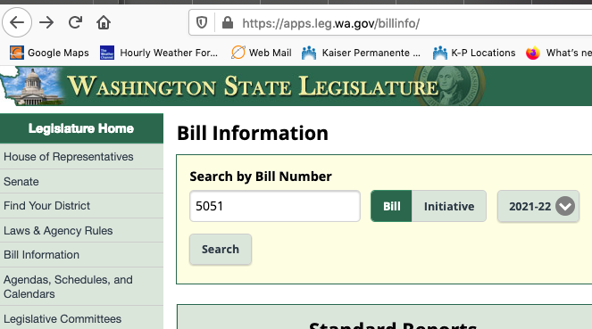
Search for Bill by Number
From any Legislative web page click on
Then enter the Bill Number (no letters) and Search
A Typical Bill’s Page
BACK to Find Another Bill’s Number from the Quaker Voice Legislative Priorities

Slide 25
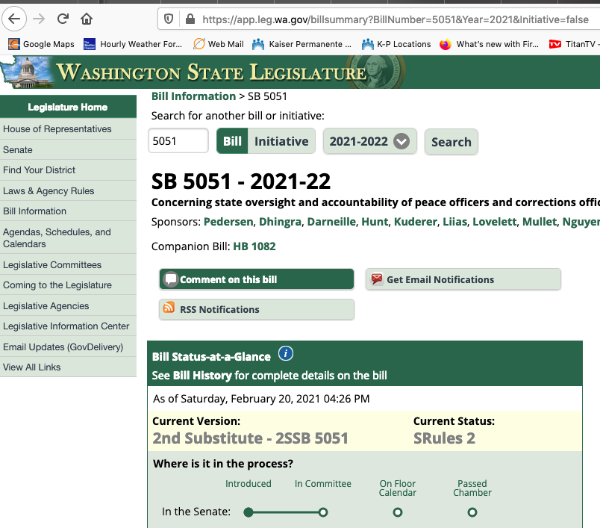
Bill SSB 5051
Senator Dhingra is a co-sponsor, we can thank her.
SSB 5051 is in Committee
More about the Bill
INDEX

Slide 26
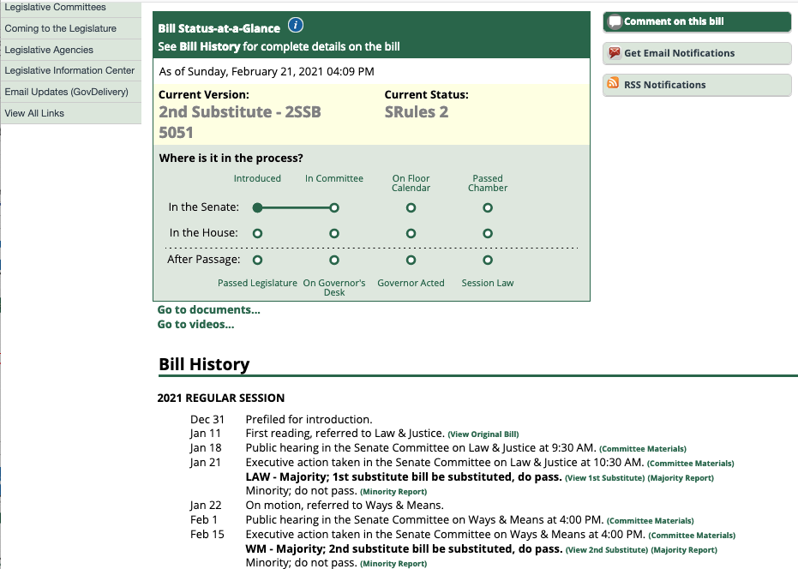
More about SSB 5051
There is a lot of information here, but what concerns us for Quaker Lobby Day is that SSB 5051 is scheduled to be voted on in the Senate Ways & Means Committee today (2/15/2021) at 4:00PM.
We also know, or will find out, Senator Dhingra sits on Ways & Means, so if we didn’t know she was a co-sponsor asking for her support there might make a difference. Thank her.
The also bill passed in Law & Justice, where she is Vice Chair.
If we wanted to see the votes for the bill in Law & Justice, we could click on the Majority and Minority reports
Top Portion of Bill Page
Record Info.
Scheduled for executive session in the Senate Committee on Ways & Means at 4:00 PM
.

Slide 27
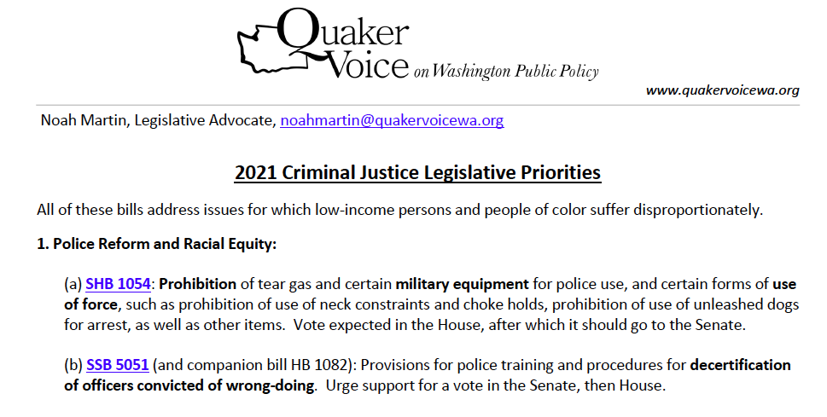
Add Information about SSB 5051 to your Legislative Priorities Information Sheet
You may want to add notes like these to your Legislative Priorities sheet, along with information from Legislators’ web pages,
Find Your Legislators
DONE
INDEX
Is in Senate Ways & Means (vote today 4:00 PM). Dhingra co-sponsored bill, & is on “Law & Justice” (Vice Chair) where passed, and “Ways & Means” (vote today 4:00 PM). – Thank her.

Slide 28

Happy Lobbying
www.quakervoicewa.org
INDEX

Slide 29
Index
Information About Legislators
Introduction
Information About Bills
Getting Started
Look for Info on Legislators
Find the Number of a QV Priority Bill
Find your Legislative District (LD)
Search for the Bill by Number
Find your Senator
Legislature’s Bill Information
Find each Representative
Record Bill Information
All the Essentials for each Legislator
Record Legislator’s Information
DONE
Happy Lobbying

