Slide 1

The 2024
Ballot Initiatives
2024 Ballot Initiatives — Quaker Voice (quakervoicewa.org)

Slide 2

The initiatives
Initiatives are a route to getting laws passed, either good ones or bad ones.
This year, the four are on the Washington ballot all repeal laws that reflect our Quaker values.
    I-2066 – Natural gas
    I-2109 – Capital gains tax
    I-2117 – Climate Commitment Act
    I-2124 – Long term care
Quaker Voice urges a NO vote on all four.
  What Quaker Voice is doing --
    Joining coalitions
    Posting information on quakervoicewa.org
    Reaching out to Quakers around the state
  You can pass the word along to your family, friends, clubs, and networks.
  Then you can vote NO.

Slide 3
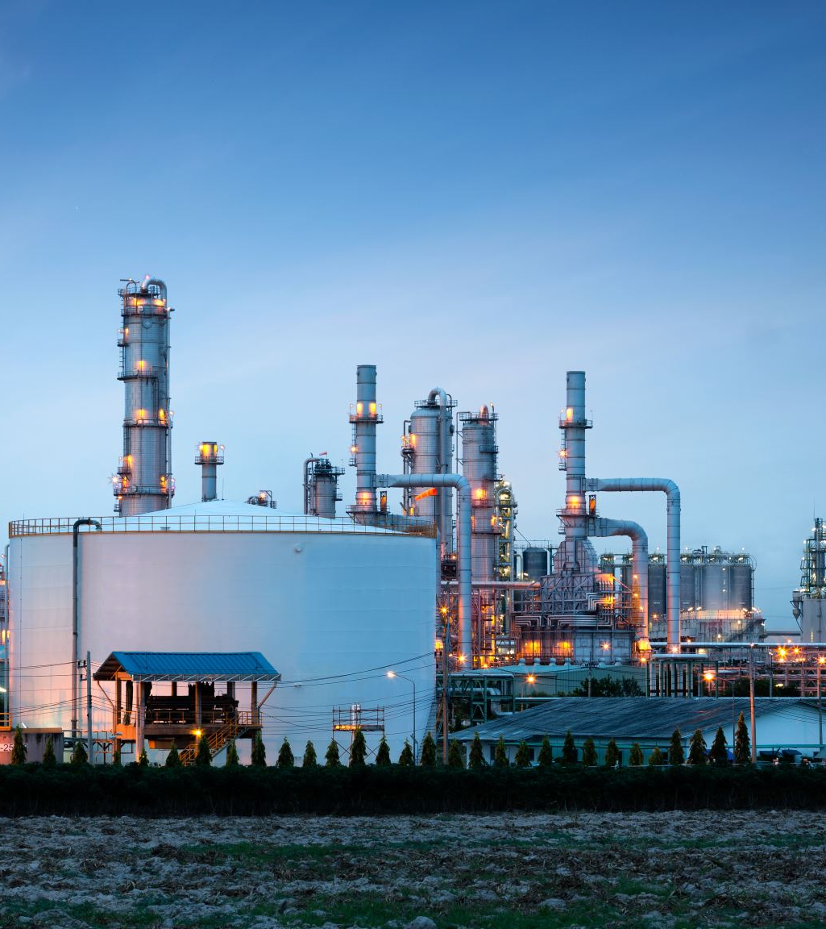
To protect clean air
Vote No on 2066
Homes using natural gas
  Have high indoor air pollution
  Cause illness from breathing harmful toxins.
Natural gas use
  Is 95% methane, a major greenhouse gas
  Will cause energy bills, especially for many low-income households, to rise
Current legislation gradually phases out new natural gas installations.
  Public utilities supported it.
Notes:
Current law limits new natural gas installations to meet greenhouse gas reduction goals.
That law was supported by major utilities as well as environmental groups.
This initiative would prohibit any limits on new natural gas installations.

Slide 4

Initiative 2066 would roll back that positive step by:
Cleaner
Cheaper
Renewable
Blocking improvements slated for buildings and appliances,
Derailing decarbonization in Washington State. The previous legislation
  Moved us away from fossil fuel energy
  Moved us towards cleaner, cheaper, and renewable sources, like wind and solar.
Eroding efforts to electrify Washington homes and businesses.

Slide 5

To save the Climate Commitment Act
Vote NO on I-2117
Protect programs that…
Improve the HEALTH of OUR COMMUNITIES,
Increase forest SUSTAINABILITY and RESILIENCE to wildfire,
Help low- and moderate-income households to SAVE MONEY on their monthly energy bills,
PRESERVE the HEALTH of our children and environment through zero-emissions school buses,
Develop clean energy projects that CREATE JOBS across our economy.
Notes:
Protect programs that…
Improve the HEALTH of OUR COMMUNITIES, especially in frontline and overburdened communities, by reducing toxic air and water pollution,
Increase the sustainability and RESILIENCE of forests to wildfire by supporting local conservation efforts,
Fund access to high-efficiency home heating appliances for low- and moderate-income households to SAVE MONEY on their monthly energy bills,
PRESERVE the HEALTH of our children and environment through zero-emissions school buses, expanded clean public transit service, and no-cost transit for youth,
Develop clean energy projects, like solar and wind, which CREATE JOBS across our economy.

Slide 6
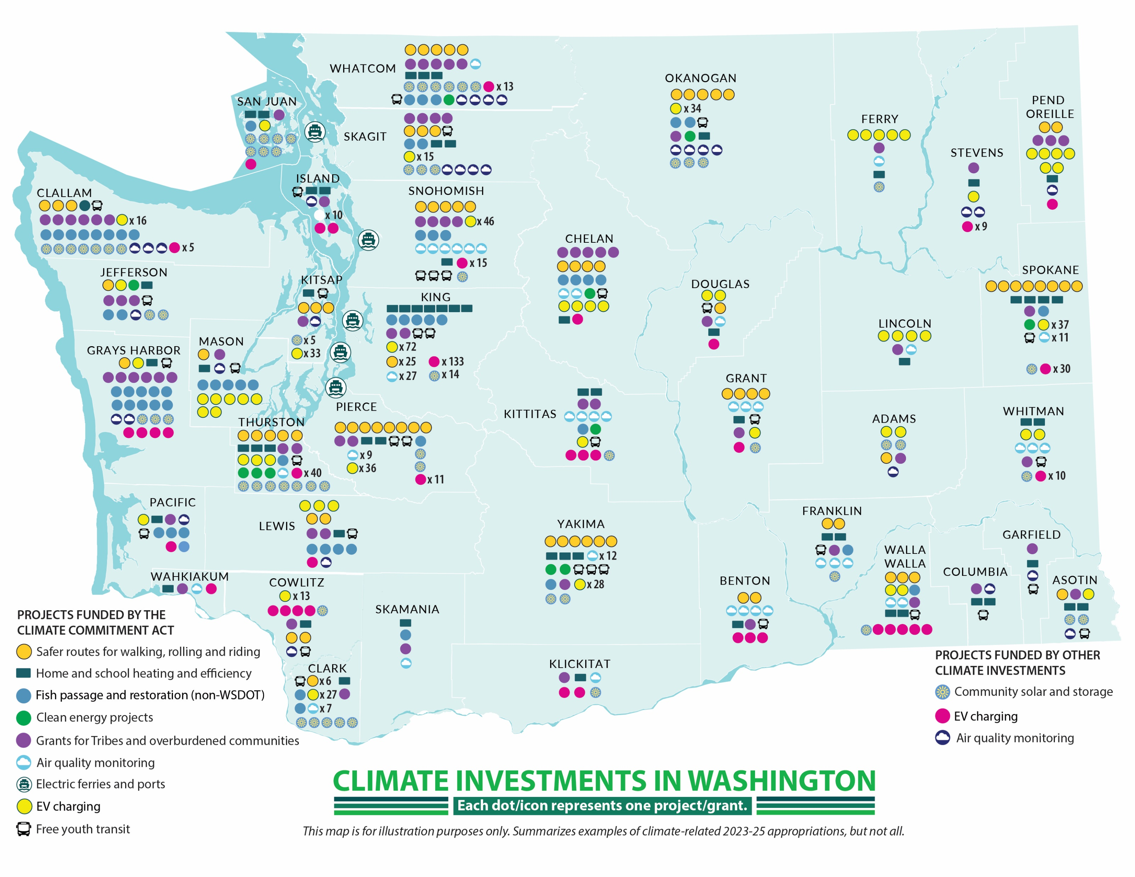
Projects around the state
Riskofrepeal.cleanprosperousinstitute.org

Slide 7
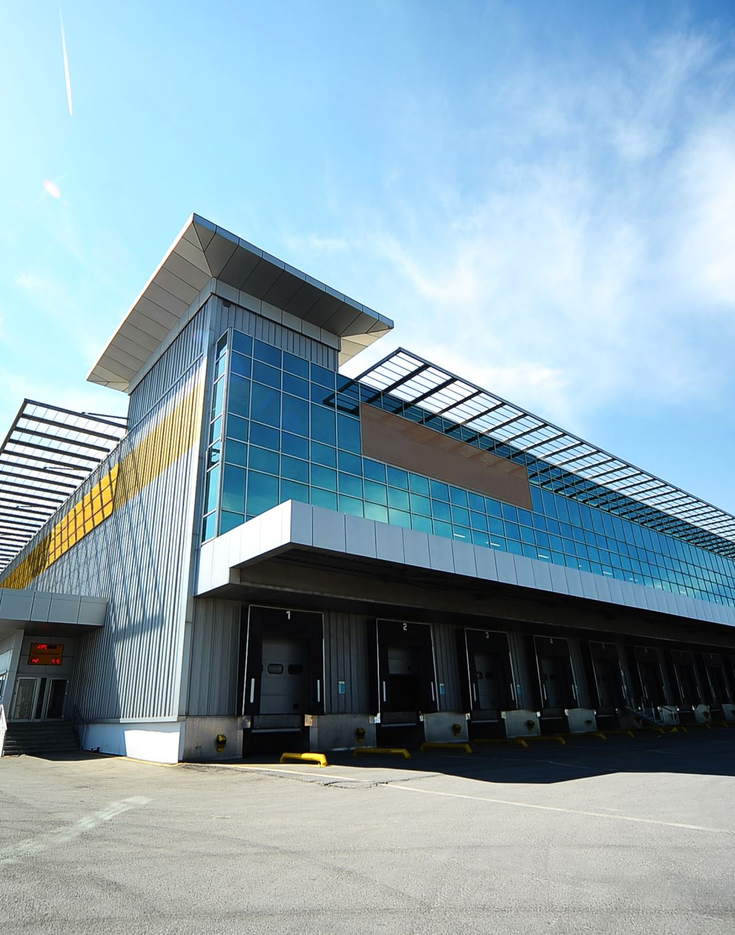
Examples of benefits from this tax on major polluters
Community EV charging – Yakima County
Decarbonization planning – Ellensburg
Energy Renewal – UW Tacoma
Hybrid Electric Vessel Construction – ferries
Fish barrier removal projects – Mill Creek
Carbon removal facility – Port Angeles
Yakama Nation Solar Project
Safe Routes to Schools Grant Program – King County
Food Waste Reduction Grants – King County

Slide 8
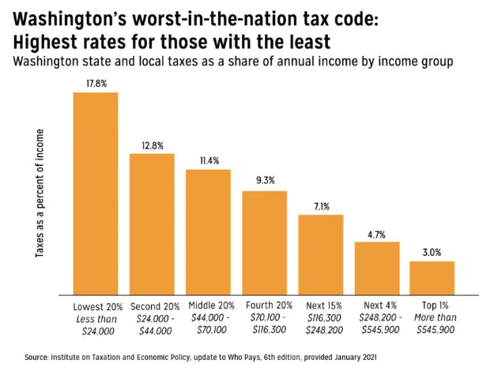
To keep the Capital Gains Tax
Vote No on I-2109
Washington has a very upside-down tax structure – worst in the nation before the capital gains tax was introduced.
The tax is 7% on the value of capital gains transactions over $250,000.
Affects fewer than 4,000 of the wealthiest people in Washington (nearly 90% of them live in King County).
This tax does NOT apply to
  any retirement accounts, including IRAs
  any real estate
  small family businesses
  farms

Slide 9

Examples of benefits
Estimated to provide $2.2 billion over five years for education, childcare, and early learning
Capital gains tax revenues can address problems such as…
  Snohomish County facing massive cuts – Edmonds, Mukilteo, Marysville, etc.
  Seattle Public Schools are facing a $105 million deficit, making big cuts
If this tax is repealed, there will be more cuts or higher sales and property taxes.

Slide 10

To keep long term care support
Vote No on I-2124
Makes paying the tax that supports the program optional.
  Expected to bankrupt it rapidly.
I-2124 hurts working women the most.
  They are the most likely to get pulled out of work to be unpaid caregivers for the elderly.
I-2124 will increase costs and send more people into debt.
  The current benefit can keep many elderly people in their homes with home modifications, medical equipment, meal delivery, a home care aide, or temporary relief for family caregivers.
I-2124 will throw us back into the expensive insurance market.
  Premium jumps, denied coverage for pre-existing conditions, etc.
Notes:
$36,500 lifetime benefit (amount adjusted annually for inflation)
Under Washington's WA Cares Fund, eligible individuals can receive up to $36,500 (adjusted annually for inflation) to cover long-term care services and supports²³. This benefit can be used for a variety of needs, including:
In-home care: Hiring a home care aide or paying a qualified family member to provide care.
Home modifications: Installing grab bars, wheelchair ramps, or other modifications to make your home safer and more accessible.
Assistive devices: Purchasing wheelchairs, scooters, medication reminder tools, and other mobility aids.
Meal delivery and transportation: Paying for meal delivery services or transportation to medical appointments.
Respite care: Providing temporary relief for family caregivers².
This program aims to help Washingtonians maintain their independence and reduce the financial burden of long-term care.

Slide 11
Thanks for voting NO on the 2024
Ballot Initiatives
2024 Ballot Initiatives — Quaker Voice (quakervoicewa.org)
Look under the Take Action tab

